Slide 1

Home automation
Make living easy
CREATED BY:
SANTOSH REDDY
UJJWAL PANDEY
SAI VIBHU LADE

Slide 2
OBJECTIVE
Emphasis on the various home automation systems which can be beneficial in day to day life.
Discover more efficient ways of making an stationary object communicate by itself and with other appliances.
Explaining how home automation will be the leading assets of technology in the near future.
Explaining how will the quality of life will upgrade with home automation.

Slide 3
WHAT IS HOME AUTOMATION ?
“Home Automation” refers to the automatic and electronic control of household features, activity and appliances. In simple terms ,it means you can easily control the utilities and features of your home via the internet to make life more convenient and secure , and even spend less on household bills.
Main purpose of home automation is “SAVE ELECTRICITY”. With this technology everyone can control the home equipment or office equipment automatically . The system is secured ,user- friendly, reliable , flexible and affordable

Slide 4
HOW DOES HOME AUTOMATION WORKS?
Home automation is a network of hardware, communication, and electronic interfaces that work to integrate everyday devices with one another via the Internet. Each device has sensors and is connected through WiFi, so you can manage them from your smartphone or tablet whether you’re at home, or miles away. This allows you to turn on the lights, lock the front door, or even turn down the heat, no matter where you are.
There are three main elements of a home automation system: sensors, controllers, and actuators.
Sensors can monitor changes in daylight, temperature, or motion detection. Home automation systems can then adjust those settings (and more) to your preferences.
Controllers refer to the devices — personal computers, tablets or smartphones — used to send and receive messages about the status of automated features in your home.
Actuators may be light switches, motors, or motorized valves that control the actual mechanism, or function, of a home automation system. They are programmed to be activated by a remote command from a controller.
THERE ARE MANY TYPES OF HOME AUTOMATION SYSTEM BUT IN THIS WE WILL ONLY DISCUSS Arduino, GSM, and Android based Home Automation and Security System

Slide 5
TYPES OF HOME AUTOMATION
HOME AUTOMATION SYSTEM USING ARDUINO
Arduino is an open source architecture that uses Atmega2 microcontroller. For programming the microcontrollers, the Arduino platform provides an integrated development environment (IDE) based on the Processing project, which includes support for C, C++ and Java programming languages. Arduino has two variants Arduino Uno and Arduino Mega, Arduino Uno has 20 pins that can be used for both input and output whereas Arduino Mega has 80 pins for input and output, so it can connect number of home equipment’s. It’s ARM (Advanced RISC Machine) based processor also speeds up the processing
Sensors of all kinds, motion, user input, light, power, communications, storage, multiplexing and port multipliers, binary logic integrated circuits, amplifier circuits, even thumbprint scanners can be connected to an Arduino as components..
This system is developed to integrate different facilities such as visitor counter, light-fan automation, temperature monitoring, and intruder alarm with a unique controller device named Arduino UNO.

Slide 6
TYPES OF HOME AUTOMATION
HOME AUTOMATION USING GSM AND ANDROID MODULE
Home automation system because of its wide spread coverage which makes it an online system. It has also become popular due to its security feature because of which it is not possible for other people to track the information sent or received. Android application is used to control various home appliances using mobile phone. A person can control various appliances of his home using an android application which is present in his mobile phone even if the person is away from his home. System can perform communication by two methods-
GSM(Global System for Mobile Communication)
Android Application
This provides internet accessibility and the speech features with extensive coverage.
The system switches the home appliances ON and OFF using the android app, Bluetooth module, and voiced prompt. It can also be timed to switch off appliances for a pre-time of 12 h, thus making the application easy and convenient to operate via a smartphone.

Slide 7
SIMULATION HOME USIND ARDUINO UNO
We are living in 21st century where automation of any form i.e. home or industrial plays an important role in human life. When it comes to industrial automation, the concept is applied to large machines or robots which helps in increasing the efficiency in terms of production, energy and time.In this project, we will design a simple home automation project using simple components using which different electrical appliances can be switched on or off. The project is based on Arduino and I have used Arduino UNO for the project.

Slide 8
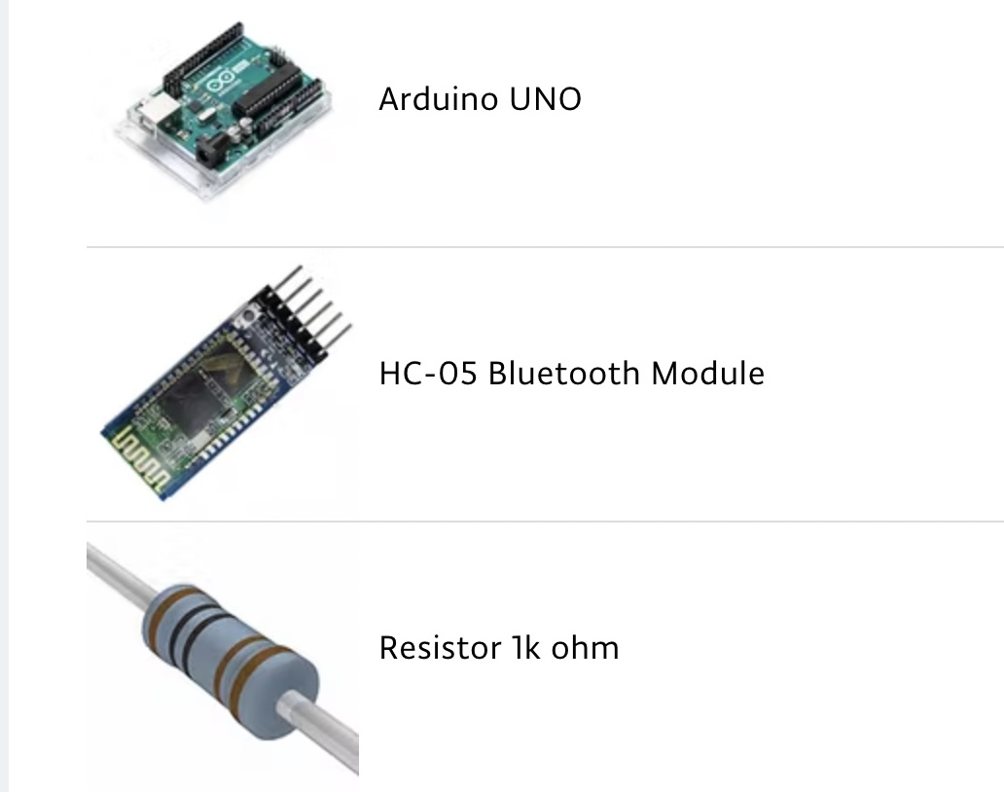
COMPONENTS AND SUPPLIES

Slide 9
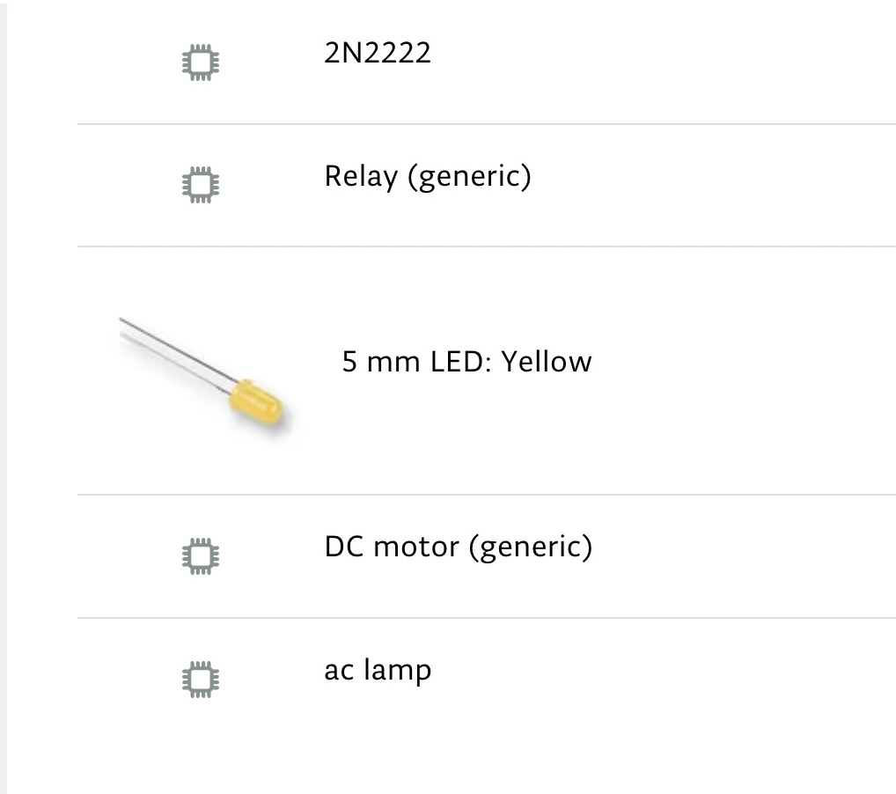
COMPONENTS AND SUPPLIES

Slide 10
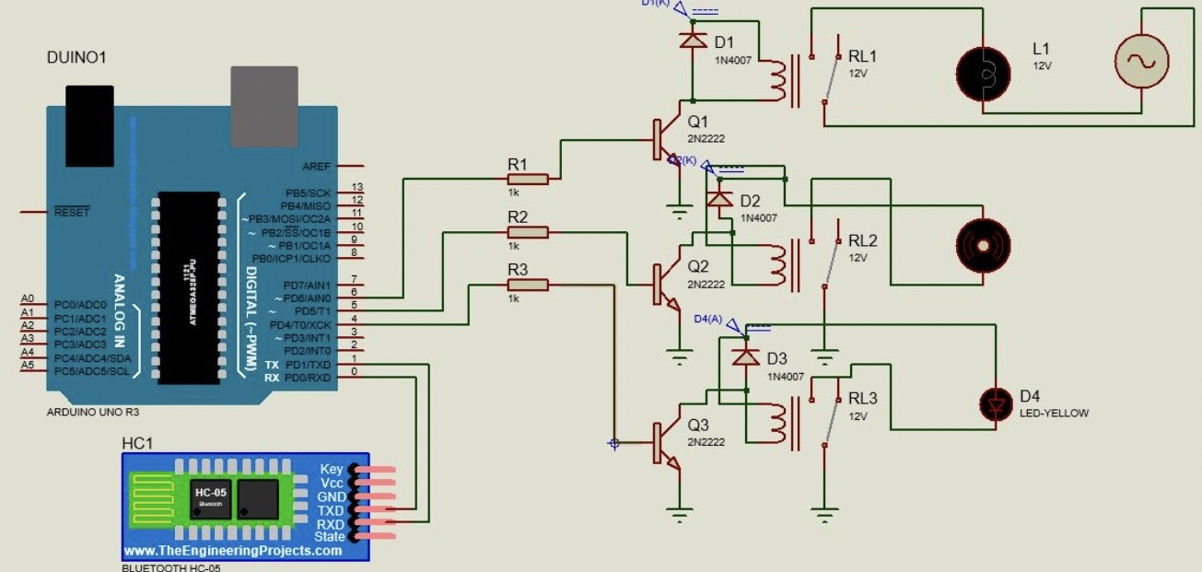
CIRCUIT DIAGRAM

Slide 11
EXPLAINATION
The last three slides explain about the components and how they are aligned to create smart home automation system which uses bluetooth to connect to your mobile phone comes with a app which can turn on or off all of your appliances with the help of your phone .
The codes for aduino are in the next slide

Slide 12
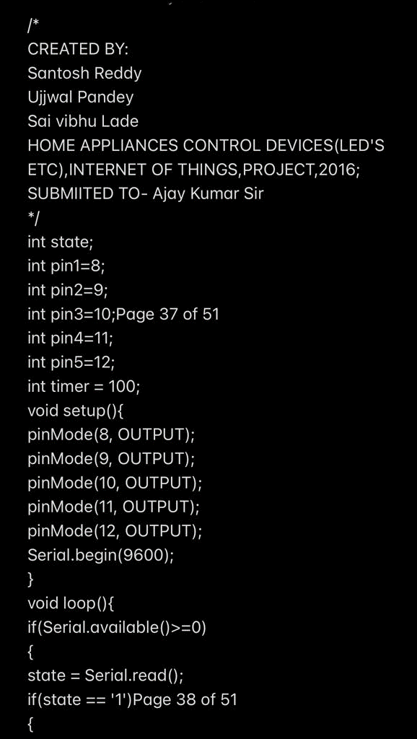
CODE

Slide 13

CODE

Slide 14

CODE

Slide 15

CODE

Slide 16
CONCLUSION
As smart homes become even more smart , systems could learn over the time and
calculate the most efficient ways to configure
the home appliance or to provide users with
recommendations on how to save energy.
Besides the technical challenges, it is
necessary to keep in mind the users'
requirements.
The price of the "intelligence" in a house in
comparison with its "body", is insignificant

Slide 17
THANK YOU

